Slide 1
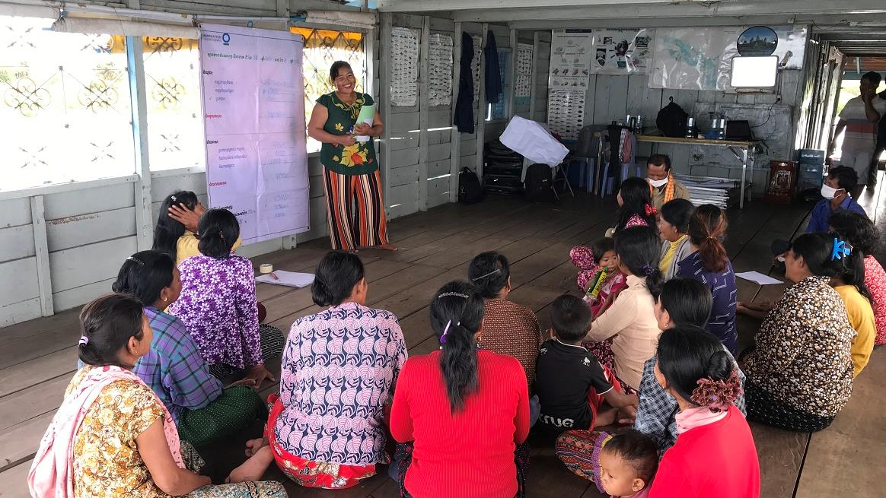
Women’s savings group meeting in Ou Akol, Cambodia. © Sokrith Heng, Conservation International
Empowering women in conservation
KNOWLEDGE PRODUCT
Keiruna
inc
TRAINING MODULES

Slide 2
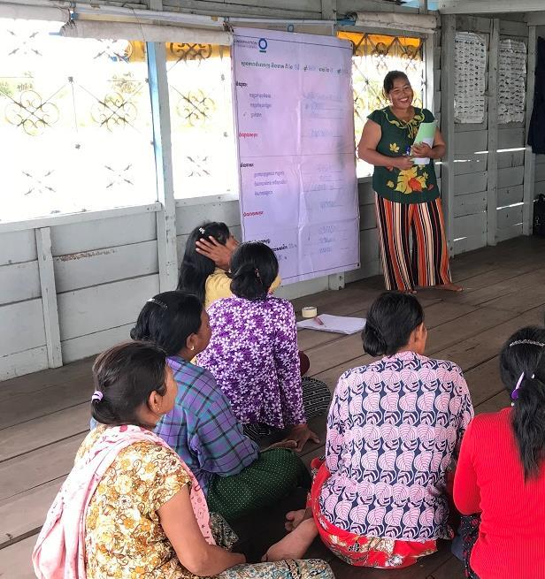
About
This knowledge product is based on experiences of CEPF Grantees in the Indo-Burma Hotspot, and is meant to provide useful information and guidelines for supporting women in conservation. Licensed under CC BY-NC 4.0.
Funded as a part of the CEPF "Building on Success" learning resource series, which aims to promote effective conservation practices across the planet.
Empowering women in conservation
How to use this knowledge product
This is a training with 3 modules that can be self-guided or delivered by a trainer to a group, with extra explanations in the optional Training Script document.
For more in-depth information on any of the topics covered, there are many useful references available, including those in the Annex (Further Learning).
CEPF is a joint initiative of l’Agence Française de Développement, Conservation International, the European Union, the Global Environment Facility, the Government of Japan and the World Bank.
Published 2021 | Author: Tara Sayuri Whitty, PhD. @ Keiruna Inc

Slide 3
EMPOWERING WOMEN IN CONSERVATION
Modules
Module 1
Module 2
Module 3
Annex
Why gender is important in conservation
Context, Rationale, and Key Considerations
Framework:
Working to empower women in conservation
Ways of thinking & Working in projects
Further learning:
Useful resources

Slide 4
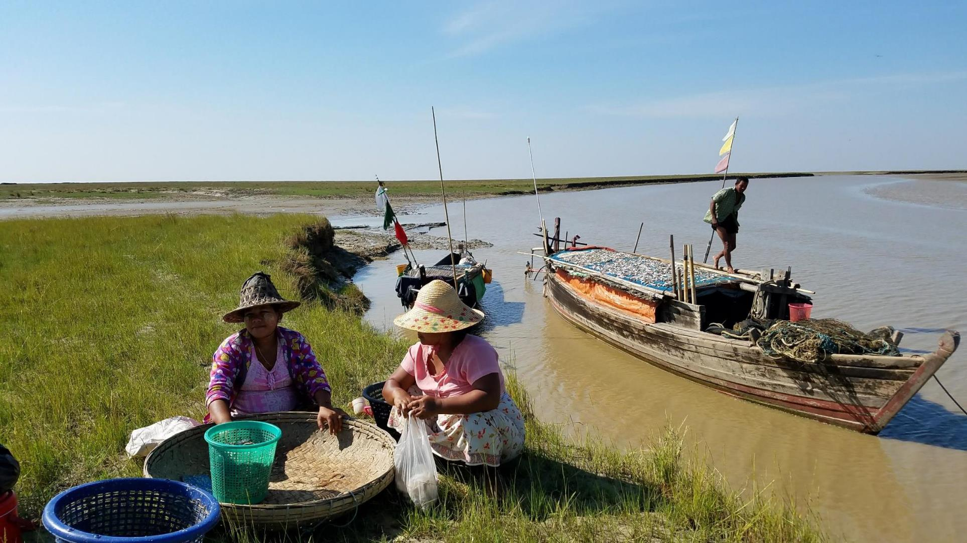
EMPOWERING WOMEN IN CONSERVATION
Women sorting through fish catch while a fisherman tends to his boat in the Gulf of Mottama, Myanmar © TSWhitty
Annex
Further Learning

Slide 5
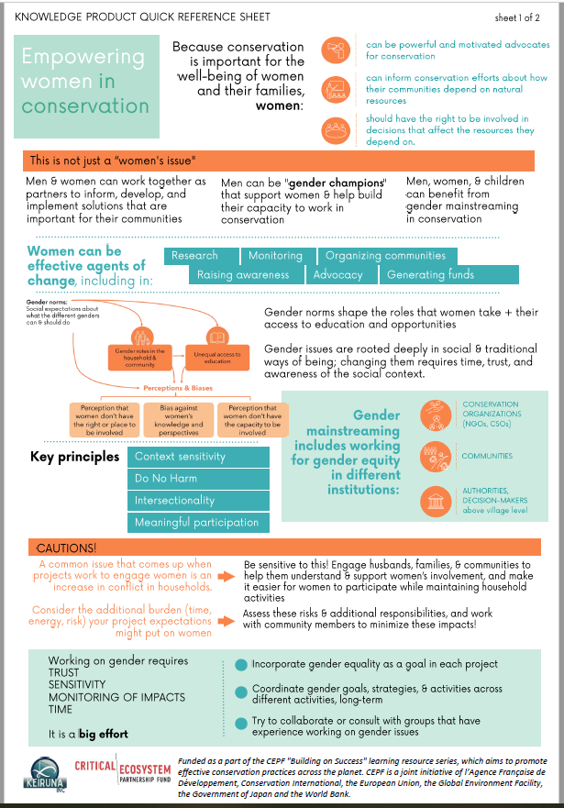
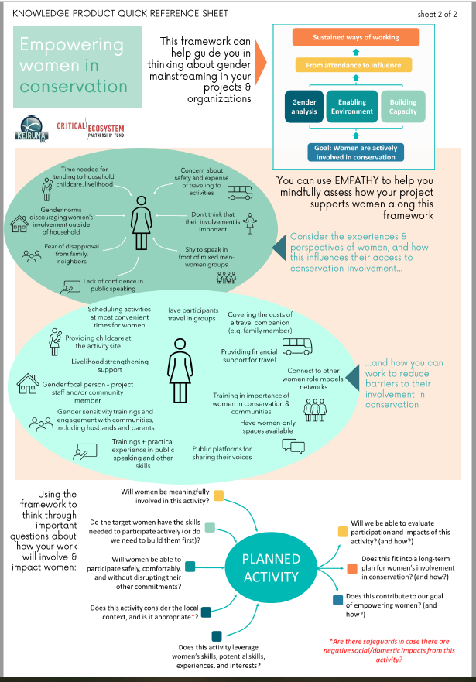
ANNEX | FURTHER LEARNING
Quick Reference Sheets of this
training
PDF

Slide 6
CEPF
ANNEX | FURTHER LEARNING
Includes links to CEPF Gender Policy, Gender Toolkit, Gender Tracking Tool
www.cepf.net/grants/before-you-apply/cepf-gender
WorldFish
Includes latest projects, manuals, blogs
www.worldfishcenter.org/research-theme/gender
Conservation Organizations’ Gender pages
IUCN
Includes news stories, publications, guidelines
www.iucn.org/theme/gender
UNEP
Includes reports, stories, areas of work
www.unep.org/explore-topics/gender
Conservation International
Includes guidelines, lessons learned, videos
www.conservation.org/priorities/gender-equality
Women’s Earth Alliance
Includes information on programs, resources, news, and stories from the field
womensearthalliance.org
Women & Rivers Network
Includes list of partners, reports, protocols
www.womenandrivers.com/

Slide 7
ANNEX | FURTHER LEARNING
Sustainable Development Goals
Information on Goal 5 (Achieve gender equality...) with publications and statements
sdgs.un.org/topics/gender-equality-and-womens-empowerment
General information on gender
International Institute for Environment and Development
Includes webinars, blogs, and case studies
www.iied.org/gender
UNDP
UNDP’s Gender Equality Strategy 2018-2021
www.undp.org/publications/undp-gender-equality-strategy-2018-2021
Food & Agriculture Organization
Includes publications, videos, and E-learning links
www.fao.org/gender/en

Slide 8
ANNEX | FURTHER LEARNING
TOOLKIT: CEPF
Gender Toolkit
www.cepf.net/sites/default/files/cepf-gender-toolkit-2018-en.pdf
TOOLKIT: Mangroves for the Future
Gender Analysis Toolkit for Coastal Management Practitioners
www.mangrovesforthefuture.org/assets/Repository/Documents/Gender-Analysis-Toolkit-for-Coastal-Management-Practitioners.pdf
Useful toolkits, guidelines, & case studies
CASE STUDY: Oxfam
Story of women taking the lead in natural resource management in Cambodia
www.oxfamamerica.org/explore/stories/women-taking-lead-cambodia
REPORT: Mangroves for the Future
Regional gender analysis for coastal resource management in Southeast Asia + Indian Ocean
www.mangrovesforthefuture.org/assets/Repository/Documents/Regional-Synthesis-Report-Gender-in-coastal-and-fisheries-resource-management.pdf
BLOGS: iied
Series of blogs on gender issues across sectors, but primarily environmental issues
www.iied.org/blogs/theme/gender

Slide 9
ANNEX | FURTHER LEARNING
CEPF Indo-Burma Hotspot Grantees
WARECOD, Vietnam
Find project reports and information for the grantees in this presentation
www.cepf.net/our-work/biodiversity-hotspots/indo-burma
News: “The Women’s Union of Long Phu District organizes a seminar on community communication, environmental monitoring and protection”
www.warecod.org.vn/en/thong-tin/news/54/672/The-Womens-Union-of-Long-Phu-District-organizes-a-seminar-on-community-communication-environmental-monitoring-and-protection.aspx
Grantee Success Story: Sustainable Fishing in Vietnam www.cepf.net/stories/grantee-success-story-sustainable-fishing-vietnam
Resources on
Indo-Burma Hotspot CEPF Grantees & Collaborators
Boon Rueang Women’s Group, Thailand
Story: “Thai women organized to protect their community’s wetland forest”
www.recoftc.org/stories/thai-women-organized-protect-their-community’s-wetland-forest
Profile & video as part of the Equator Prize 2020
www.equatorinitiative.org/2020/06/04/boon-rueang-wetland-forest-conservation-group/
International Rivers
Gender rights: Project information, publications
www.internationalrivers.org/issues/human-rights/gender-rights/

Slide 10
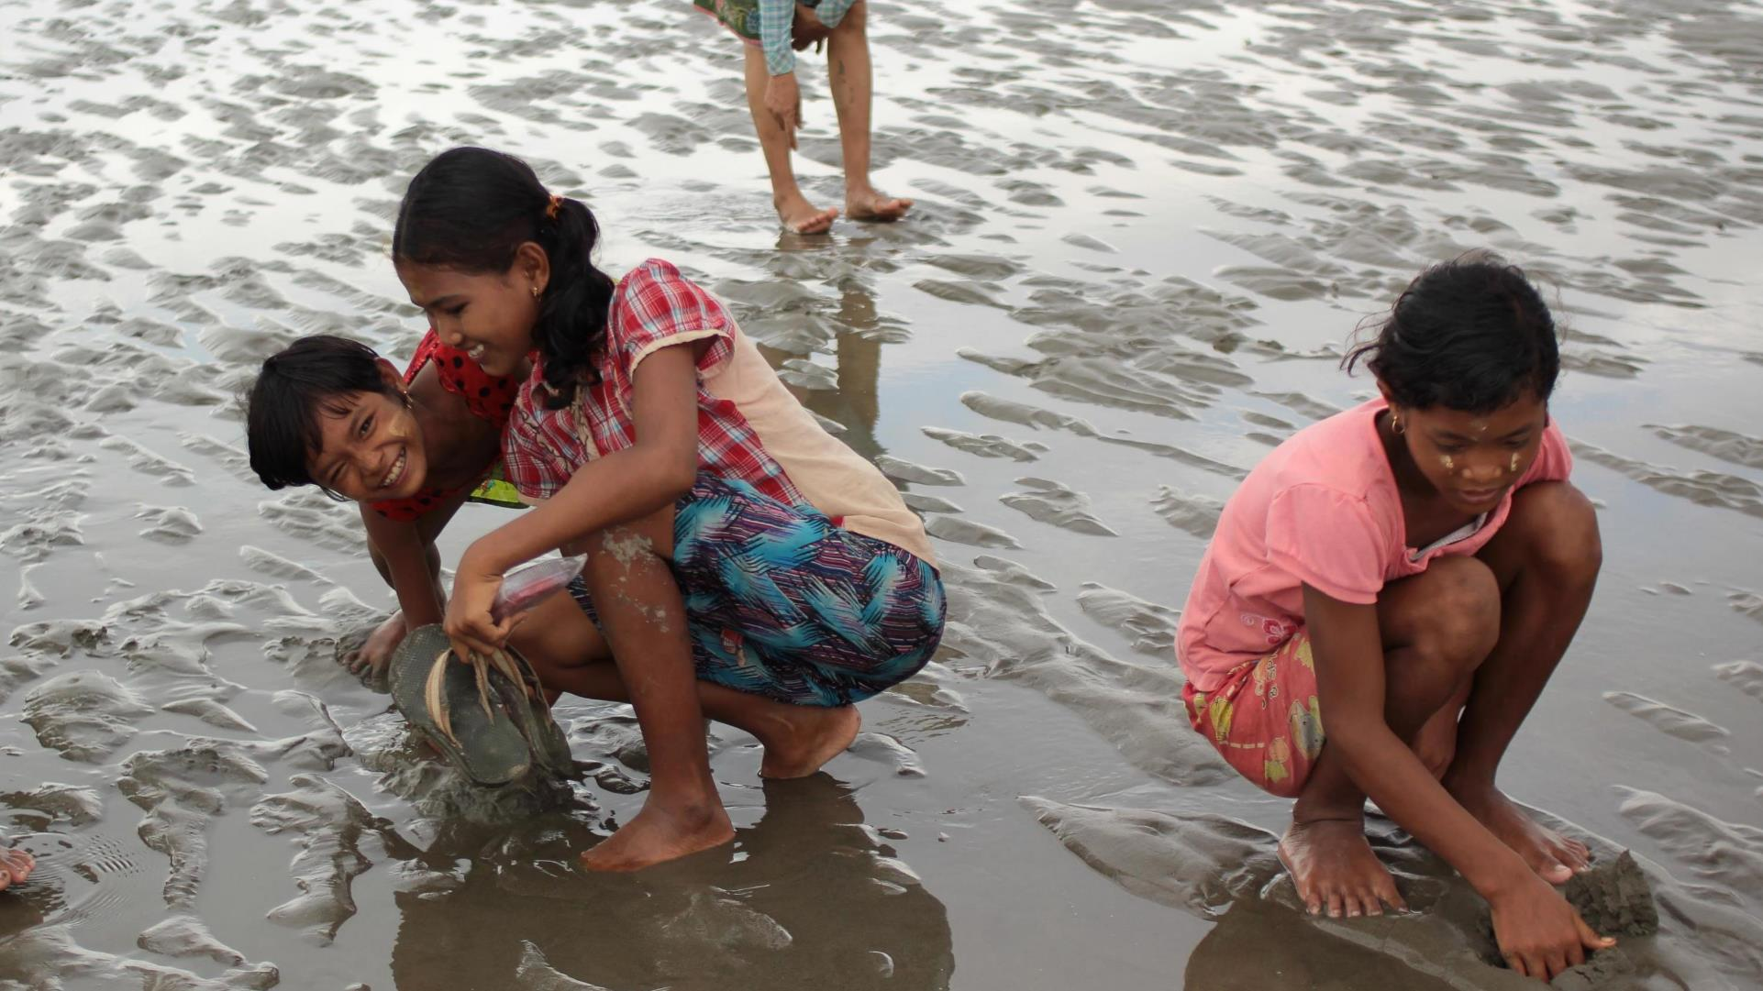
Girls gleaning at low tide in Mon State, Myanmar. © TSWhitty
EMPOWERING WOMEN IN CONSERVATION
Acknowledgements
3S Rivers Protection Network (3SPN) | Leang Bunleap
Cambodian Indigenous Youth Association (CIYA) | Nun Sokunthea
Cambodian Rural Development Team (CRDT) | Or Channy
Center for People and Nature Reconciliation | Thuy Hang Nguyen
Center for Water Resources Conservation and Development (WARECOD) | Nguyen Thi Ngoc Lan
Conservation International (CI) | Nick Souter, Vann Layhim, Sokrith Heng
FISHBIO | Sinsamout Oundboundisane, Jack Eschenroeder, Eva Salas, Erin Loury
Fisheries Action Coalition Team (FACT) | Youk Senglong
Global Environmental Institute (GEI) | Yunzhu Chen
GreenViet Biodiversity Conservation Center | Trang Le
Highlanders Association (HA) | Mong Vichet
International Rivers | Gary Lee
Mekong Community Institute Association (MCI) | Teerapong Pomun
Mekong Watch | Toshi Doi
My Village | Por Narith, Kry Solany
Southeast Asia Development Program (SADP) | Leang Rattanak Tevy
WorldFish Camboya | Kosal Mam
Many thanks to these organizations & individuals who provided information for this training!

